Slide 1

Create
Step-by-step guide to a more efficient elearning process.
5C Framework for successful digital learning

Slide 2
Create:
The third C of the 5C framework
If you’re following the 5C Framework, you will have Captured your audience and their needs, and used this information to Conceptualize a clear vision for a piece of digital learning that will meet those needs.
Now for the nitty gritty: it’s time to Create that digital learning in your chosen authoring tool. This is where your vision comes to life and is shared with learners. Thinking through your creation process and involving others at the right time will help you build your digital learning quickly and see a high quality output straight away.
This Create Guide will help you and your team through the building process. Have it on hand as you sit down at your computer, and tick off your progress as you go.
Need some support? Find out more about our Learning Consultancy team and our coaching and design services at each stage of the 5Cs Framework.

Slide 3
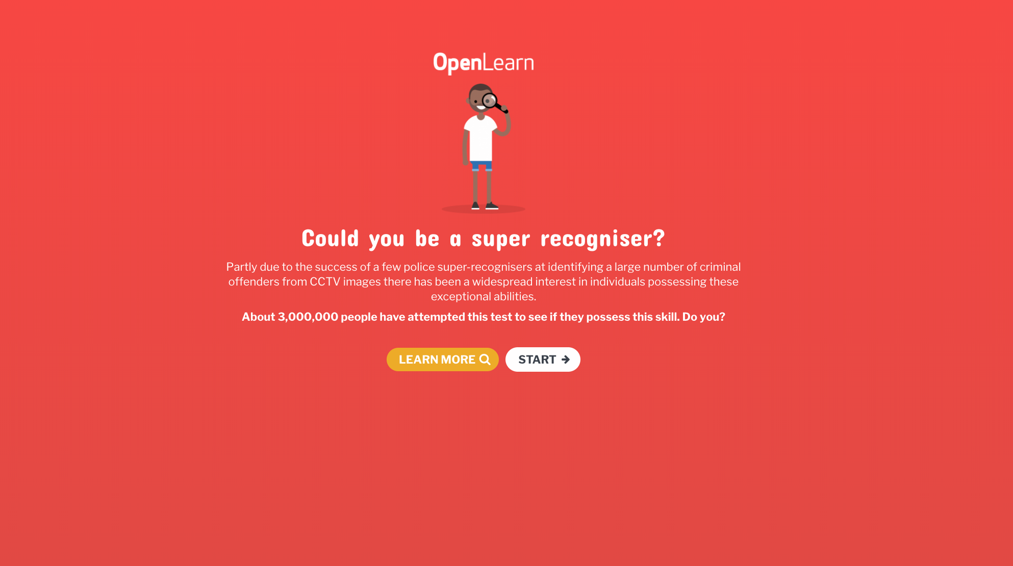
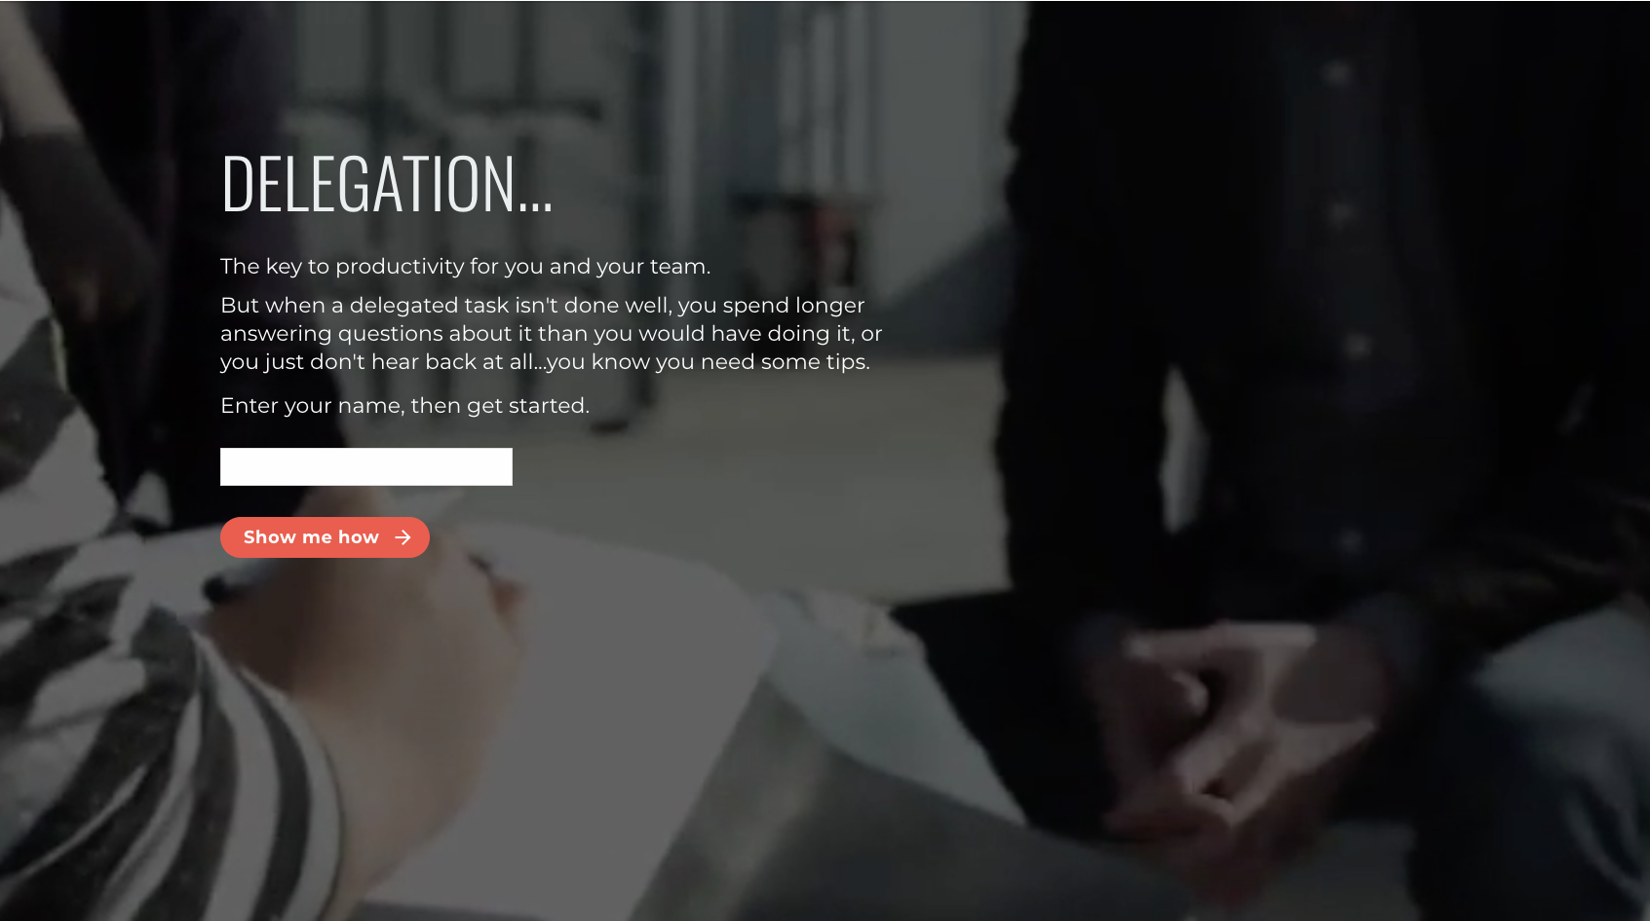
1
Start with the style
First impressions matter, including your own first impression of your work. So, before you get too far, get your core visuals set up so everything you create looks on-brand:
Logo
Font
Primary and accent brand colours
Talk to your brand team if you’re not sure where to find this information.
When the basics are in place, you can get into the fun part of styling - how you bring your content to life with imagery.
Take a look at the examples on the right to see just how different elearning can look with different style applied.

Slide 4
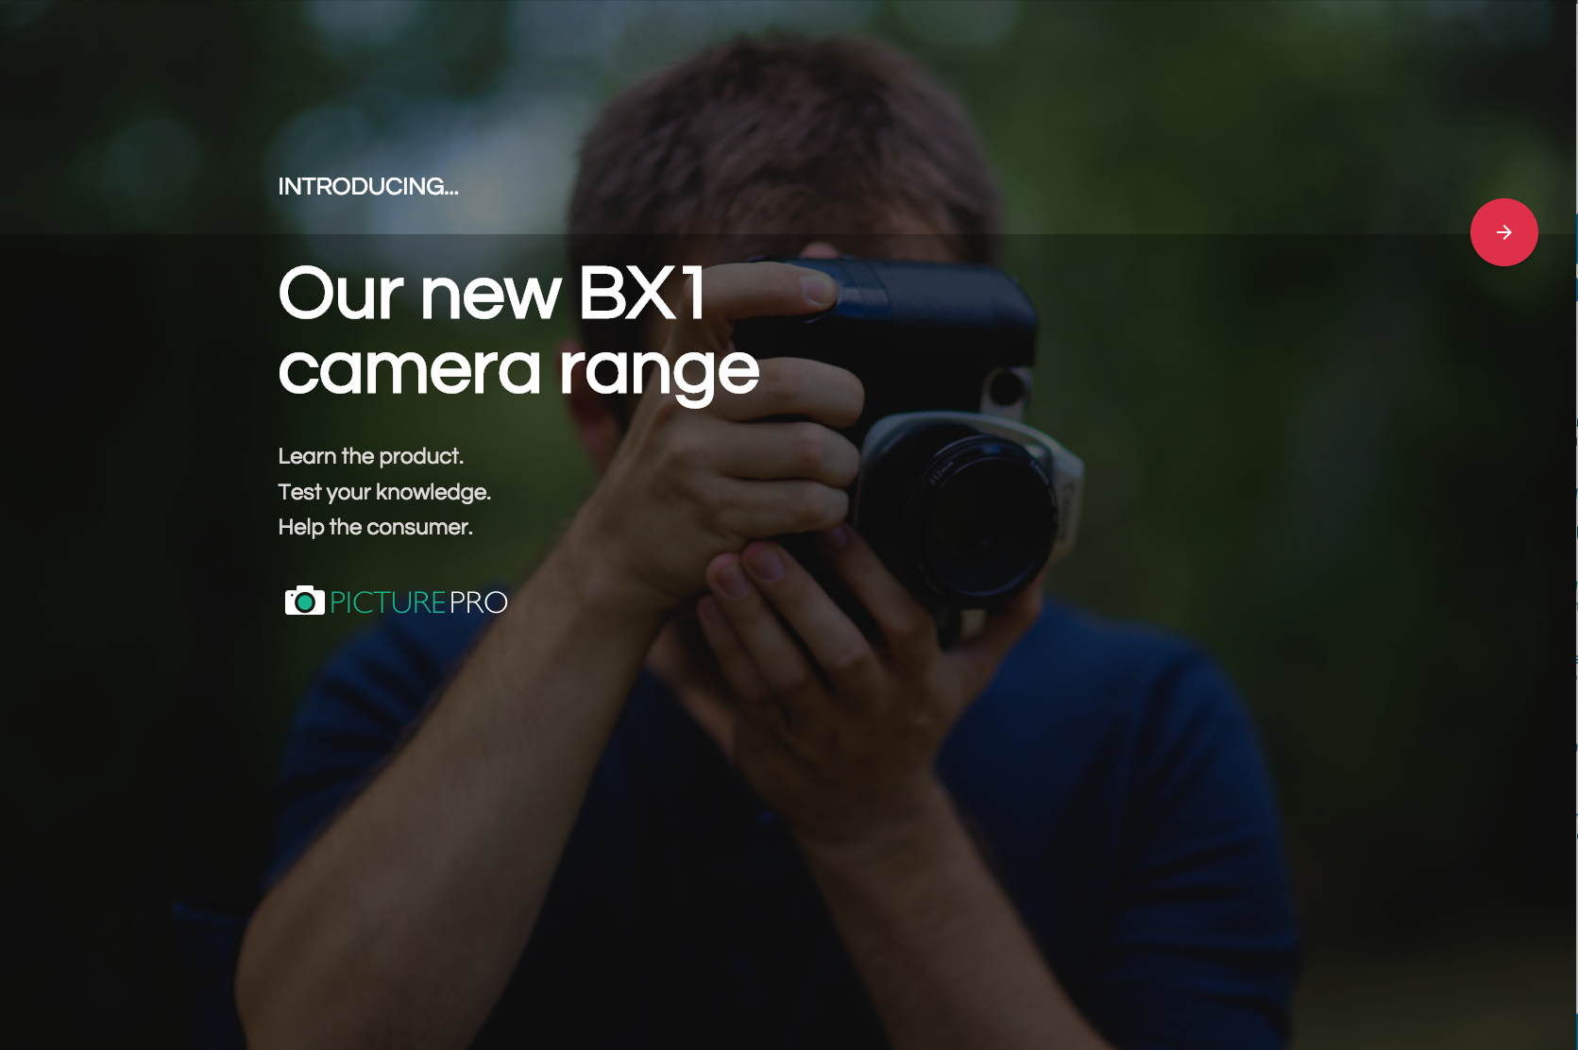
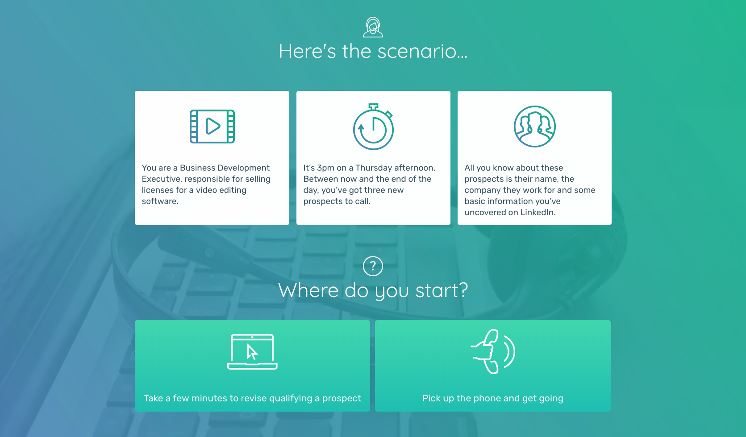
What’s your style?
Some examples here might jump out at you as being the perfect fit for your project. But if you're not sure which way to go, consider these 5 factors.
Do you have graphic design skills or access to a graphic designer? If not, illustrative approaches will be challenging.
Do you have a company image library? If so, check out what’s available there as a starting point.
Could you take your own photos? Images of your own people in your own environments will be relevant and feel personal.
Is your subject matter quite conceptual? If so, photos might be tricky, and icons could work well instead.
Don’t forget that often, less is more. Don’t underestimate the impact of block colour backgrounds and simple imagery.

Slide 5
2
Build a short section
Put your content to the test by bringing a short section of your digital learning to life onscreen.
Which section should you start on? Look back at wireframe from the Conceptualize Guide (or your content plan) and, with that in mind, answer these questions.
Which parts need to be visualized in order to be sure that they’ll work?
Are there any structures that are replicated throughout the learning?

Slide 6
One of the sections you’ve listed above is a good place to start with your build. It will allow you to prototype a complex or integral section and, at the same time, test the following:
Navigation
Is your user journey clear enough?
Are your navigation buttons situated in obvious enough places?
Do the buttons stand out against your other visuals?
Flow
Does the content in your first few screens flow together?
Is there enough linking and instructions on what’s coming up next?
Engagement
Put yourself in the learners shoes.
Is this section holding your attention?
Do you want to keep interacting?
Do you feel like you’re getting something useful?
Reflect
What improvements would you like to make as you build the rest of your digital learning?

Slide 7
3
Collaborate with others to complete your build
When you’ve set a standard with your first section, work with your team to build out the rest.
Team members could take any of the following roles:
Subject Matter Experts (SMEs)
Experts on the subject you’re training people about, as opposed to learning design experts. They can provide content, examples and quiz questions for you to incorporate into your learning.
Co-authors
Colleagues who are helping you build the digital learning. If your chosen authoring tool is cloud-based, as Elucidat is, you can work on your build simultaneously from any location.
Reviewers
Colleagues who can give you a second opinion, either on the accuracy of the content or the user experience. Elucidat has a handy review feature that allows colleagues to leave notes for you throughout the course.
Sign-off points
Stakeholders who have sign-off over your finished product. It’s often useful to release or publish your finished build at this stage, so your stakeholders don’t get distracted by the authoring interface.

Slide 8
4
QA and iterate
Now, it’s time to quality assure your work. This might not seem like the most glamorous part of the job, but it’s the difference between your learners focussing on the learning and focussing on your typos and broken buttons!
Jot down what needs to change so you can retest after fixing it:
Text | Visuals | Function
Proofread for spelling, punctuation and grammar. Check that the writing all follows the same tone of voice. Make sure you’re using bullet points, capital letters and US/UK English consistency. | Check that all the images, colours and fonts are on-brand. Ensure all your images support a learning point rather than acting as “wallpaper”. Make sure all visuals are displaying correctly at a high resolutions. | Test every interactive element, from navigation buttons to audio files to hyperlinks. Check the translation from storyboard to script - are the right answer options correct and incorrect. Most importantly - does the product as a whole meet your objective.

Slide 9

In summary…
If you follow these steps to Create your digital learning content, you’ll achieve better results, faster.
Decide on your style and branding
Build on a short section to test your concept
Gain feedback and input from key stakeholders
Quality assure your digital learning
Don’t forget, this process is only as good as the planning that comes before it. Make sure you start out any new digital learning project by Capturing your audience needs and Conceptualizing your elearning ideas before you begin the build.
Find out more about the 5C Framework.

Slide 10

Create
What next?
Get more 5C Framework guides These will help you to generate design concepts, speed up your production process and much more! Discover our coaching and design services Get hands on support and guidance to help you deliver real-life impact from your projects. Talk to us We’d be happy to help with any questions you have about this guide and discuss how we can help you further.
We hope you’ve found this guide useful!
Getting a streamlined, efficient process locked down is the key to delivering projects on time without undue stress!
If you’d like one-to-one support from our Learning Consultancy team, please get in touch.

